Slide 1
North Dakota ghosts
Merricourt, North Dakota
Forbes, North Dakota School

Slide 2
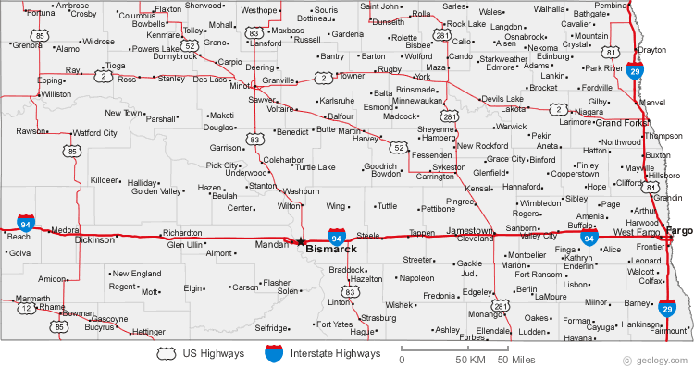
Merricourt
Notes:
http://geology.com/cities-map/north-dakota.shtml

Slide 3
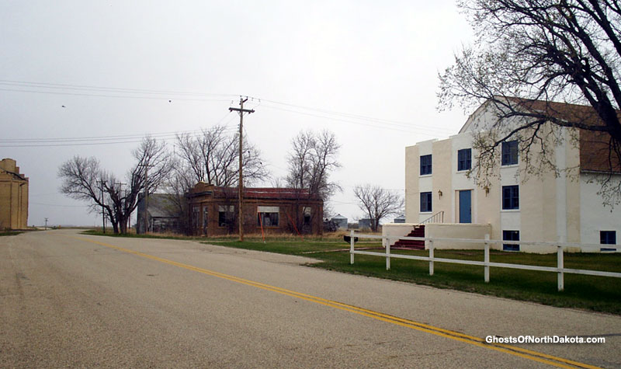
North Dakota ghost town: Merricourt, North dakota
Notes:
Merricourt is a relic because all that remains of this town is the buildings. Merricourt became a ghost town because the railroad closed their train depot.
http://www.ghostsofnorthdakota.com/wp-content/uploads/2005/05/mainstreet4lg.jpg

Slide 4
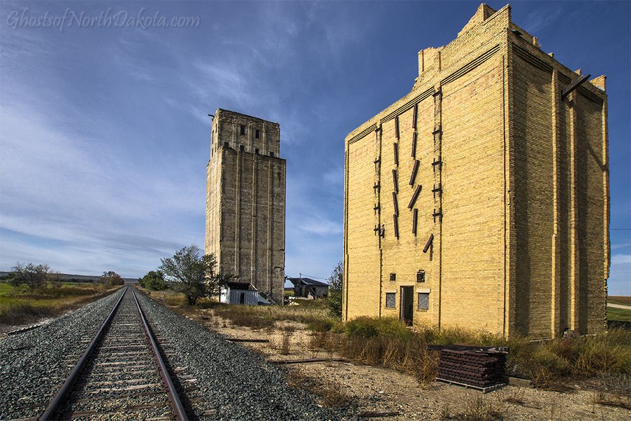
Grain elevators
Notes:
Ask students to use their vocabulary words to describe this picture. An example of a word that could be used is remote.
http://www.ghostsofnorthdakota.com/wp-content/uploads/2016/02/merricourt9.jpg

Slide 5
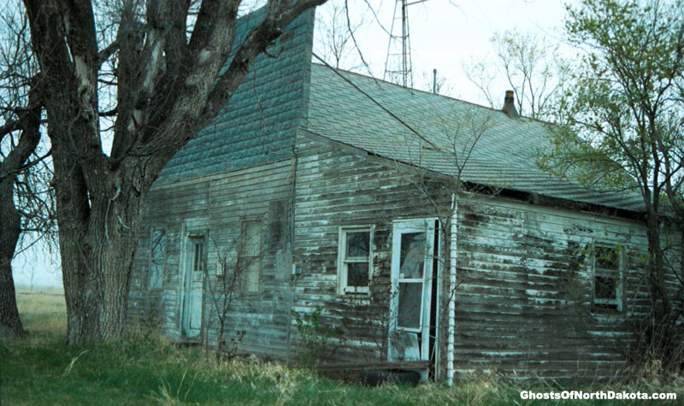
Post office
Notes:
This is a post office and a house in the same building. The postmaster and his wife lived here.
http://www.ghostsofnorthdakota.com/wp-content/uploads/2005/05/merricourtpolg.jpg

Slide 6
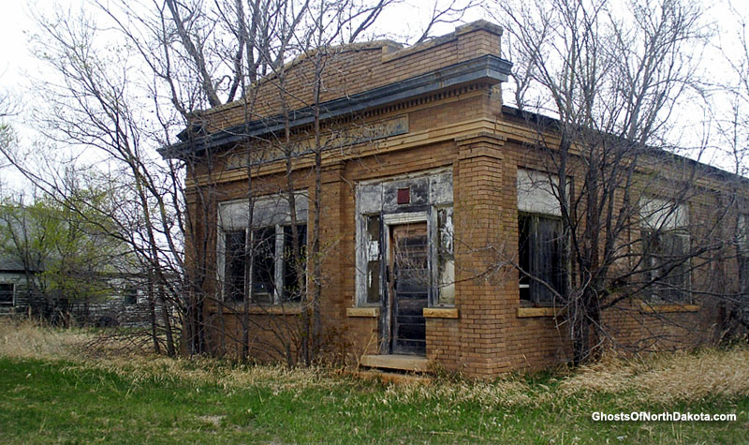
Merricourt first state bank
Notes:
Ask students to use their vocabulary words to describe this picture. An example of a word that could be used is abandoned.
http://www.ghostsofnorthdakota.com/wp-content/uploads/2005/05/banklg.jpg

Slide 7
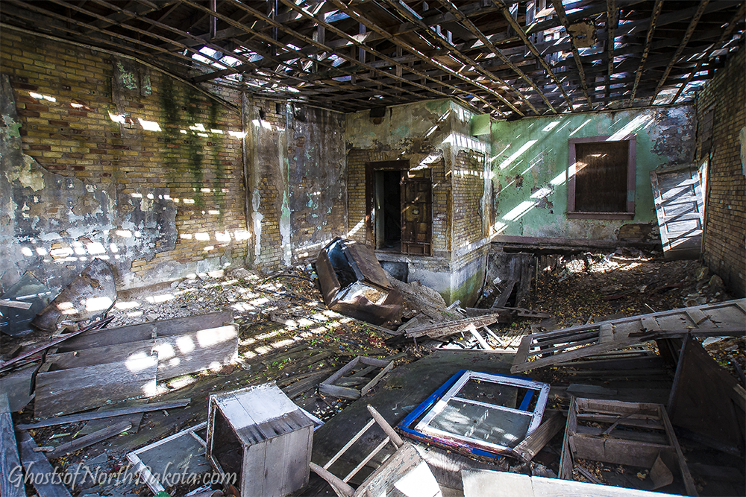
Inside of the bank
Notes:
The roof of the bank is caving in and the floor is collapsing. If something is not done to restore this building soon all that will remain of it in the future will be its vault. You can see the vault in the very back of the bank. It is the only part of the bank not collapsing.
Ask students to use their vocabulary words to describe this picture. An example of a word that could be used is rubbish.
http://www.ghostsofnorthdakota.com/wp-content/uploads/2016/02/merricourt5.jpg

Slide 8
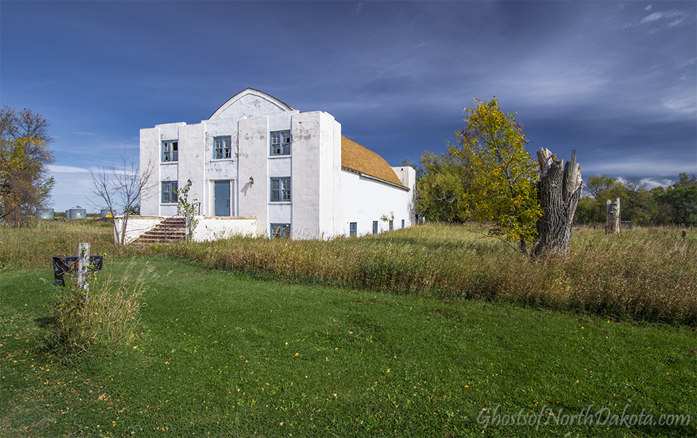
Merricourt community center
Notes:
Do you think this building is still being used by people?
http://www.ghostsofnorthdakota.com/wp-content/uploads/2016/02/merricourt2.jpg

Slide 9
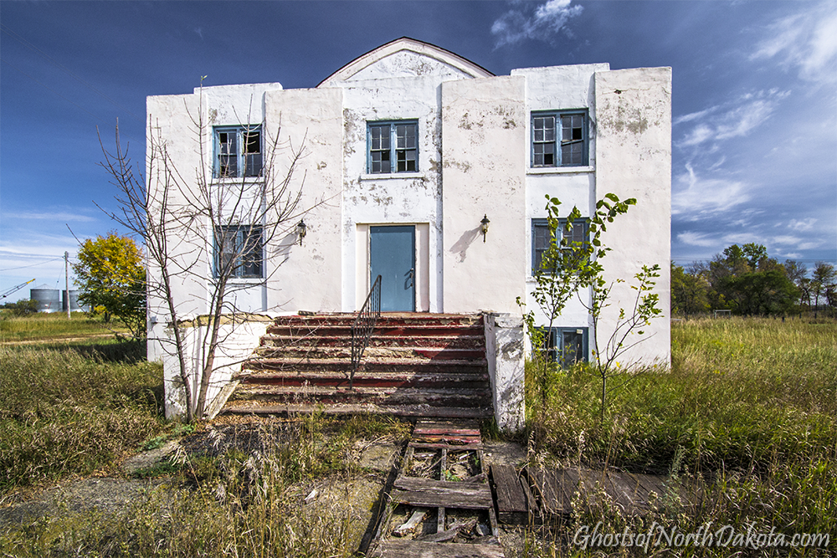
Merricourt community center close-up
Notes:
http://www.ghostsofnorthdakota.com/wp-content/uploads/2016/02/merricourt1.jpg

Slide 10
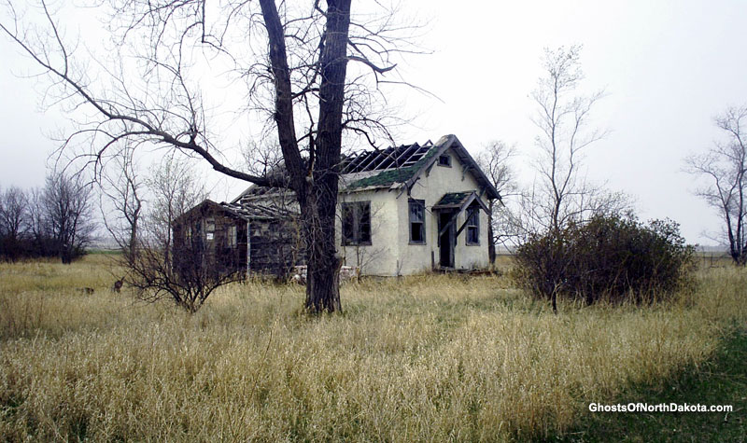
House in merricourt
Notes:
Ask students to use their vocabulary words to describe this picture. Two examples of words are vacant and haunting.
http://www.ghostsofnorthdakota.com/wp-content/uploads/2005/05/house1lg.jpg

Slide 11
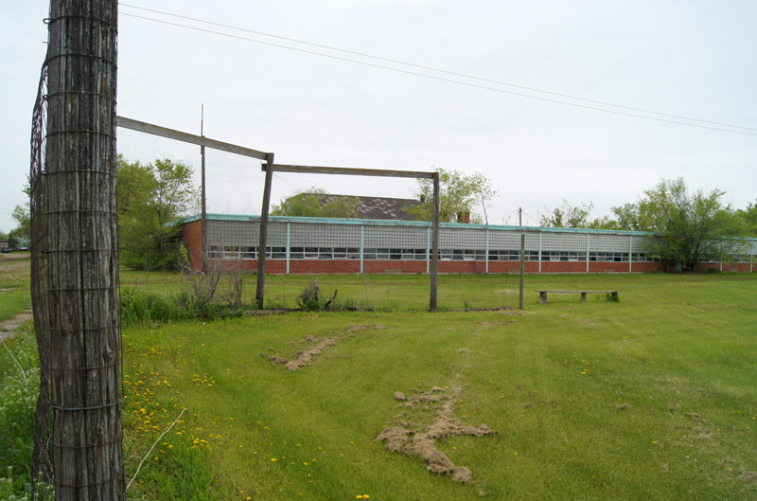
Ghost school in Forbes, North Dakota tour
Notes:
http://www.ghostsofnorthdakota.com/wp-content/uploads/2012/11/forbes-school6.jpg

Slide 12
Front doors of the school
Notes:
Principal’s office is behind wall with yellow blocks.
http://jeah.net/~troylarson/sonictremormedia/gnd/towns/galleries/forbes/forbes10.jpg

Slide 13
Front doors
Notes:
http://www.ghostsofnorthdakota.com/wp-content/uploads/2012/11/forbes-school13.jpg

Slide 14
Front inside entry
Notes:
Ask students to use their vocabulary words to describe this picture. An example of a word that could be used is rubbish.
http://www.ghostsofnorthdakota.com/wp-content/uploads/2012/11/forbes-school8.jpg

Slide 15
Long hallway in school
Notes:
The school was only one floor for Kindergarten through twelfth grade, so the hallway was very long. At the end of the hallway, you can see a little speck of light, which is the door at the other end of the hallway.
Ask students to use their vocabulary words to describe this picture. An example of a word that could be used is haunting.
http://www.ghostsofnorthdakota.com/wp-content/uploads/2012/11/forbes-school4.jpg

Slide 16
classroom
Notes:
Ask students to use their vocabulary words to describe this picture. A word that could be used is overrun.
http://www.ghostsofnorthdakota.com/wp-content/uploads/2012/11/forbes-school2.jpg

