Slide 1
Laura Ingalls Wilder
By Miss Cornell

Slide 2
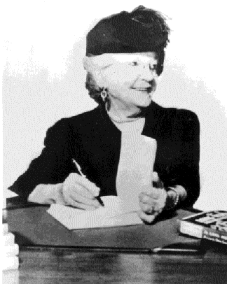
Introduction to Laura Ingalls Wilder
https://www.youtube.com/watch?v=muZrZiGVd8k

Slide 3
The long winter

Slide 4
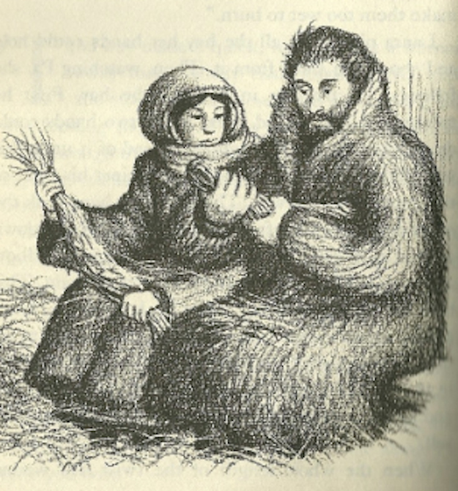
Pa and Laura twisting hay sticks.
Notes:
http://www.zimbio.com/Kara+Lindsay/articles/u_qXKrRUxma/31+Things+Learned+Laura+Ingalls+Wilder

Slide 5
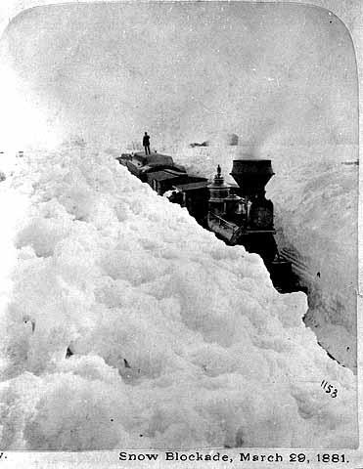
Snow Blockade March 29, 1881
Notes:
http://www.pinterest.com/tymestone/tis-winter-now/

Slide 6
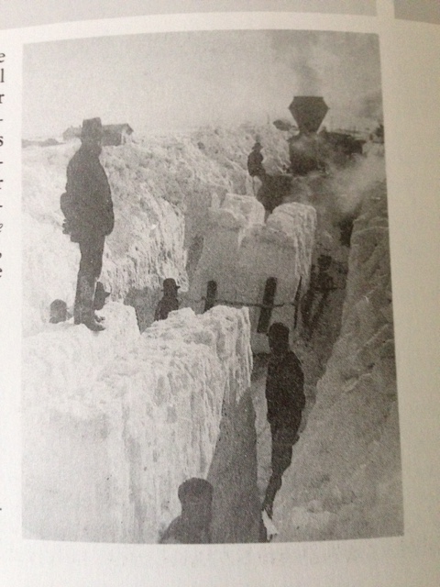
Stranded Freight Train
“A stranded freight train on the prairie during the ‘Hard Winter’ of 1880-81” (Laura Ingalls Wilder Country, p. 60).

